Slide 1


HEART DISEASE PREDICTION
RNS INSTITUTE OF TECHNOLOGY
BENGALURU - 98
DEPARTMENT OF INFORMATION SCIENCE & ENGINEERING
Presentation on Internship
Presented By
Balesh S 1RN19CS027
Chetak G 1RN19CS031

Slide 2
AGENDA
Abstract
About the Company
Introduction
Literature Survey
Requirements
System Design
Detailed Design
Implementation
Results
Conclusion and Future Enhancements
References
Q & A

Slide 3
ABSTRACT
Heart disease is a major cause of death throughout the world. It is hard to know or predict by medical practitioners as it requires expertise and higher knowledge of prediction.
The environment in healthcare sector is information rich but it have lacks of knowledge. A lot of data is available in healthcare systems over the internet but there is a lack of effective analysis tool to discover hidden patterns in data.
An automated or self- made system will increase medical efficiency and decrease cost and time. This software goal to know or predict the occurrence of a disease based on the data which is collected from Kaggle.
The Main aim is to extract the hidden patterns by applying Machine Learning techniques on the dataset and to predict or know the presence value on a scale. The prediction of heart disease requires a large size of data which is too massive and complex to process and Analysis by conventional technique. Our goal is to find out an suitable technique that is efficient and accurate for prediction of cardiac disease.

Slide 4
ABOUT THE COMPANY
NASTECH – New Age Solutions & Technologies
NASTECH is formed with the purpose of bridging the gap between Academia and Industry.
Nastech is one of the leading Global Certification and Training service providers for technical and management programs for educational institutions.
They collaborate with educational institutes to understand their requirements and form a strategy in consultation with all stakeholders to fulfill those by skilling , reskilling and upskilling the students and faculties on new age skills and technologies.
Industry and project oriented student training programs.
Certification programs mapped to Global Certification Exams from Microsoft/EC- Council/Google/AWS/ Adobe).

Slide 5
INTRODUCTION
It is difficult to identify heart disease because of several contributory risk factors such as diabetes, high blood pressure, high cholesterol, abnormal pulse rate and many other factors.
The diagnosis of heart disease is usually based on signs, symptoms of the patient.
The severity of the disease is classified based on various methods like K-Nearest neighbor algorithm(KNN), Decision Trees(DT), Logistic Regression and XGBoost.
The nature of heart disease is complex and hence, the disease must be handled carefully. Not doing so may affect the heart or cause premature death.
MAIN OBJECTIVE: The main objective of this research is to develop a heart prediction system. The system can discover and extract hidden knowledge associated with diseases from historical heat conditions data set.

Slide 6
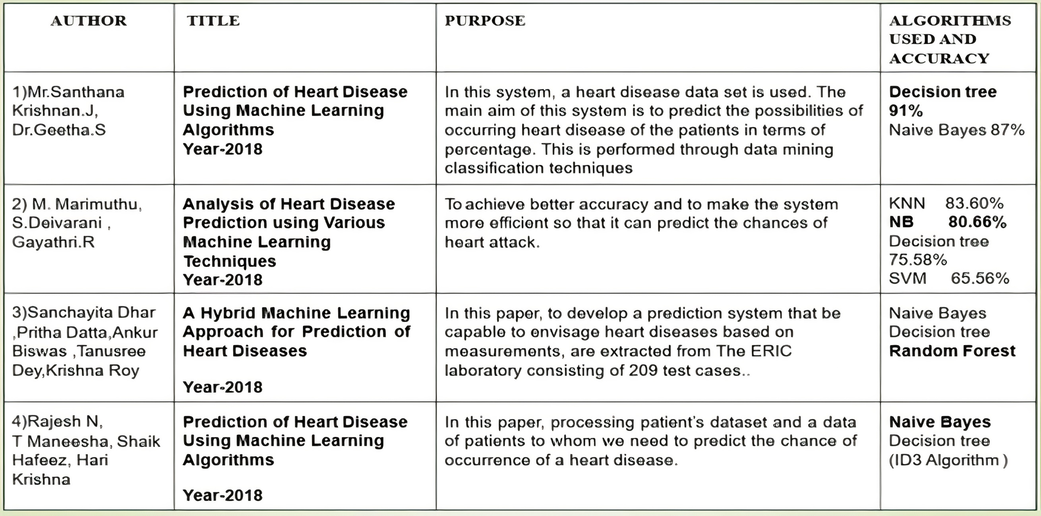
LITERATURE SURVEY

Slide 7
REQUIREMENTS
HARDWARE REQUIREMENTS
Processor : Any Processor above 500 MHz
RAM : 512Mb
Hard Disk : 4 GB
Input device : Standard Keyboard and Mouse
Output device : VGA and High Resolution Monitor
SOFTWARE REQUIREMENTS
Operating system : Windows 10
IDE : Jupyter Notebook, Google Colab
Tools/Technologies : Python, Computer Vision, OpenCv, Keras API, Numpy library

Slide 8
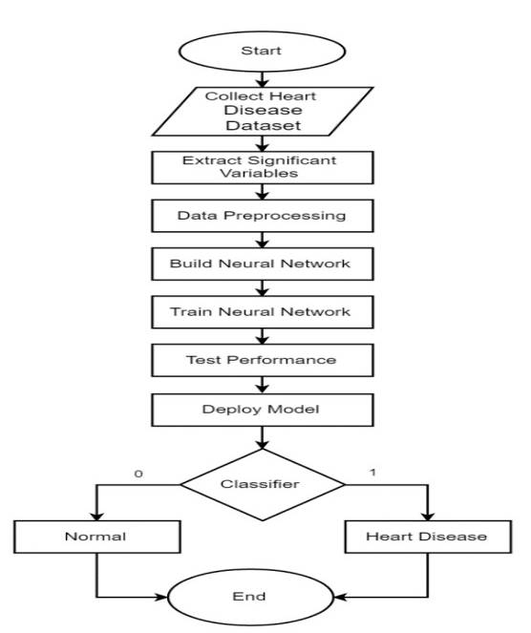
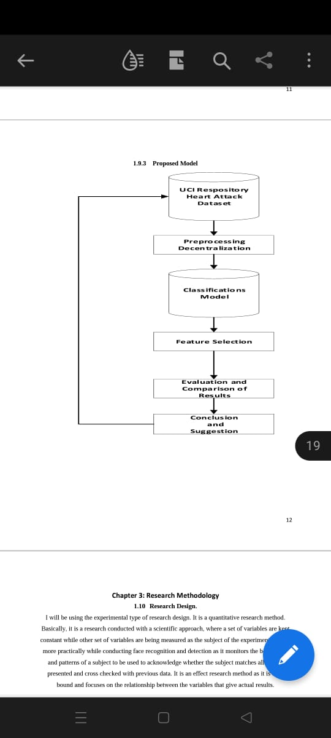
PROJECT FLOW
The data set for this research was taken from Kaggle. It has 918 rows and 7 column’s.
The significant variables that were extracted are age, Restingbp, Cholesterol, FastingBS, MaxHr, Oldpeak. These are considered as the input variables
We are collecting all the numerical features basically of type int64 and float64. Also, with the categorical features of type strings
The target variable is the value either 0 or 1 which indicates presence of disease or not
To build the model, we have to do normalization and scaling and later we do model fitting
Once the model is trained, different model is tested against the input for the result.
The accuracy of the models are also tested.

Slide 9
DETAILED DESIGN
models deployed
Logistic Regression
KNN Classification
Decision Tree
Logistic Regression
It predicts a dependent variable based on one or more set of independent variables to predict the outcomes.
It can be used for both binary classification and multi-class classification
The LR model is trained with splitting condition and tested with test data for prediction. The algorithm results in 1 for presence and 0 in absense
2. KNN Classification
K nearest neighbors classification is a type of instance based learning or non generalizing learning which stores instances of the training data.
It predicts a new point by finding a predefined number of training samples closest in distance
Weights can also be given for classifying a new point. In scikit learn each neighbor and can either be given uniform weight or can be given weights proportional to the inverse of the distance from the query point or a user defined weight

Slide 10
IMPLEMENTATION
TRAINING CODE
#train and test variables
from sklearn.model_selection import train_test_split
#whenever we take train_test_split into consideration , by default we have 4 variable
#the variable names can be changed ,but their order should not be changed
x_train,x_test,y_train,y_test = train_test_split(x,y,random_state = 0)
#random_state =0, in train_test_split , the data is randomly allocated to variables
#but once allocated , we want the data to be constant
->x.Shape
->x_train.shape
->x_test.shape
->y.shape
->y_train.shape
->y_test.shape
#normalization or scaling - done only for inputs
from sklearn.preprocessing import MinMaxScaler
scaler = MinMaxScaler()
x_train = scaler.fit_transform(x_train)
x_test = scaler.fit_transform(x_test)
#apply classifier /regressor/clusterer
from sklearn.linear_model import LogisticRegression
model = LogisticRegression()
#model fitting
model.fit(x_train,y_train) # we fit the training data
#predictor variable
y_pred = model.predict(x_test)
y_pred # predicted values
#ACCURACY FOR LOGISTIC REGRESSION MODEL
from sklearn.metrics import accuracy_score
accuracy_score(y_pred,y_test)*100

Slide 11
IMPLEMENTATION
TESTING and STREAMLIT
from sklearn.tree import DecisionTreeClassifier
model = DecisionTreeClassifier(max_depth=3, random_state=0)
#model fitting
model.fit(x_train,y_train)
%%writefile app.py
import streamlit as st
import numpy as np
st.title("HEART FAILURE PREDICTION")
age = st.slider('Age', 10, 80, 5)
rbp = st.slider('Resting BP', 100, 200, 10)
chstrl = st.slider('Cholestrol', 50, 300, 20)
MHR = st.slider('MaxHR', 60,200, 10)
from sklearn.preprocessing import MinMaxScaler
scaler = MinMaxScaler()
x_trai = scaler.fit_transform(x_train)
from sklearn.tree import DecisionTreeClassifier
model = DecisionTreeClassifier(max_depth=3, random_state=0)
model.fit(x_trai,y_train)
op = model.predict([[age,rbp,chstrl,MHR]])
st.title(op)
Streamlit Integration
!pip install -q streamlit
!pip install pyngrok
! streamlit run app.py &
npx localtunnel --port 8501

Slide 12
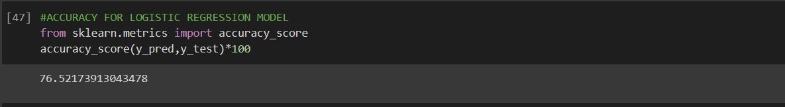
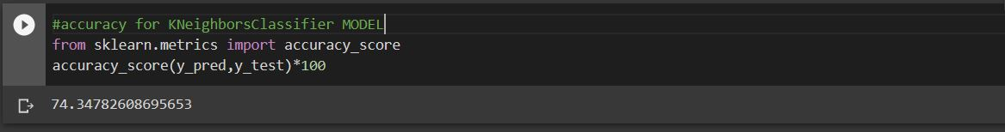
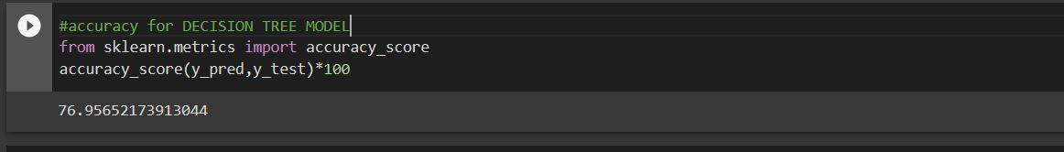
RESULTS
The accuracy of various model for the given datasets are mentioned below
The accuracy of the model LOGISTIC REGRESSION IS 76.5%
The accuracy of the model KNNEIGBORCLASSIFFIER IS 74.34%
The accuracy of the model DECISION TREE IS 76.95%

Slide 13
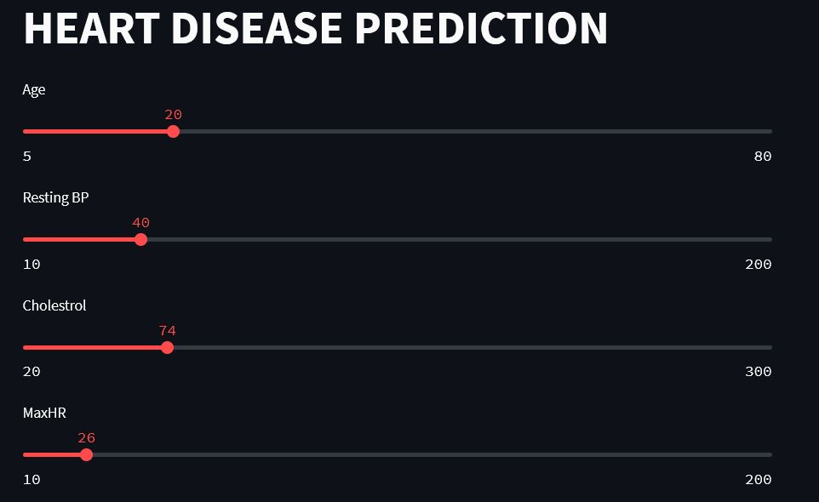
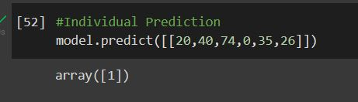
RESULTS

Slide 14
CONCLUSIONS
This project provides the deep insight into machine learning techniques for classification of heart diseases. The role of classifier is crucial in healthcare industry so that the results can be used for predicting the treatment which can be provided to patients.
The existing techniques are studied and compared for finding the efficient and accurate systems. Machine learning techniques significantly improves accuracy of cardiovascular risk prediction through which patients can be identified during an early stage of disease and can be benefitted by preventive treatment.
It can be concluded that there is a huge scope for machine learning algorithms in predicting cardiovascular diseases or heart related diseases. Each of the above mentioned algorithms have performed extremely well in some cases but poorly in some other cases.

Slide 15
FUTURE ENHANCEMENTS
To enhance the functionality of the prediction engine providing the details of 5 nearest hospitals or medical facilities to the user input location.
Provide a user account which allows the user to keep track of their medical test data and get suggestions or support to meet the right specialists or the tests to be taken
• Provide admin controls to upload, delete the dataset which will be used to train the model
• Automate the process of training the model and extracting pickle files of the trained models which will be consumed by the API’s to predict the disease.
• Mail the detailed report of the prediction engine results along with the information of 5 nearest medical facilities details having location and contact information.

Slide 16
REFERENCES
Effective heart disease prediction using hybrid machine learning techniques:- Gautam Srivastava.
[GITHUB]
Prediction of Heart Disease Using machine learning: Aditi Gavhane, Gouthami Kokkula, Isha Pandya, Prof.Kailas Devadkar - 2018.
[ACADEMIA – RESEACH PAPER]
Prediction of Heart Disease at early stage using AI and ML: A survey - Mr.Santhana Krishnan.J, Dr.Geetha.S 2019
Prediction of Heart Disease using Machine Learning Algorithms:- Sathish Vivek
[KAGGLE]

Slide 17
Question and Answer

Slide 18
THANK YOU

